Slide 1
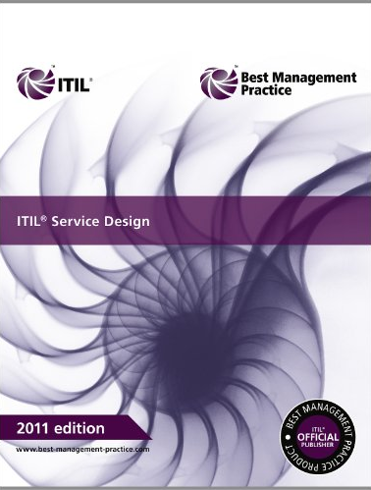
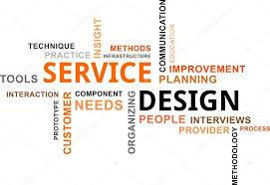

Slide 2
Overview
This provides guidance for the design and development of services and Service Management processes;
The goal of the Service Design Lifecycle is to design new or changed services for introduction into the live environment;
It is important that a holistic approach to all aspects of design is adopted, and to consider all aspects when changing or amending any of the individual elements of design.

Slide 3
Main objetives
Satisfy business objectives
Developed and enhanced within appropriate timescales and costs;
Design efficient and effective processes supported by the Service Portfolio, to manage services through their lifecycle;
Identify and manage risks, so they can be removed or mitigated before the go live;
Design secure and resilient IT infrastructure, environments, applications and data/ information resources and capability that meet the current and future needs;

Slide 4
Main objetives
Design measurement methods and metrics;
Produce and maintain IT plans to meet current and future agreed business needs;
Assist in the development of policies and standards, incorporating the actions into a continual process of improvement;
Develop the skills and capability, making effective and efficient use of all IT service resources;
Contribute to the improvement of the overall quality of IT service, especially by reducing the need for reworking and enhancing services.

Slide 5
Scope
New and changed services: Requirements are extracted from portfolio and each requirement is analyzed, documented and agreed. A solution design is then produced and compared with the strategies from Service Strategy;
Service Portfolio and Service Catalog: To ensure that the new/changed services are consistent with all other services;
Technology architectures and management systems: To ensure that all the existing technology architectures and management systems are consistent with the new/changed service, and have the capability to operate and maintain the new service;
Processes required: To ensure that the processes, roles, responsibilities and skills have the capability to operate, support and maintain the new/changed service;
Measurement methods and metrics: To ensure that the existing measurement methods can provide the required metrics on the new/changed service.

Slide 6
Benefits : Value to business
-Improves
Quality of Service (QoS);
Consistency of service;
Service alignment;
Information and decision making
-Reduced Total Cost of Ownership (TCO);
-Easier implementation of new or changed services;
-More effective Service Management, IT processes and performance.

Slide 7
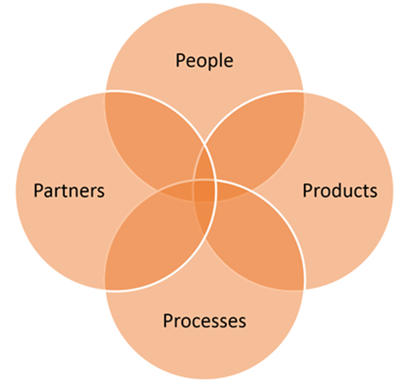
Key Concept: The Four P's
People customer, stakeholders and staff;
Processes methods more or less flexibles;
Products services, technology and tools;
Partners suppliers, manufacturers and vendors;

Slide 8
Service Design Package (SDP)
A document defining all aspects of an IT service and its requirements through each stage of its lifecycle.
A SDP should be produced during the design stage for:
-Each new service
-A major change to a service
-Removal of a service
-Changes to the Service Design Package itself
Requirements are received from Service Level Package (SLP) part of Service Strategy (SS) and
phase to Service Design (SD);
Outcomes (SDP) it is passed from Service Design (SD) to the Service Transition (ST) to evaluate, build, test, and deploy the new or changed service.

Slide 9
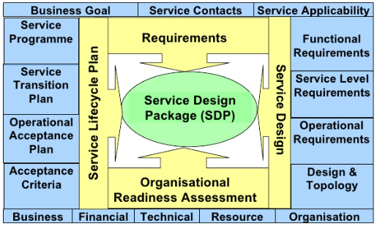
SDP Relations

Slide 10
Five Major Aspects of Service Design
Design of new or changed services;
Design of the Service Portfolio, including the Service Catalog;
Design of the technology architecture and management systems;
Design of the processes required;
Design of measurement methods and metrics.

Slide 11
Identifying Business Requirements
Re-using or exploiting existing components wherever possible;
Design the service solutions to the new requirements, including their constituent components;
Ensure the Service Acceptance Criteria (SAC) are incorporated into the initial design;
Evaluate the cost alternative designs, highlighting advantages as well as disadvantages of the alternatives;
Agree the expenditure and budgets;
Re-evaluate and confirm the business benefits;
Agree the preferred solution and its planned outcomes and targets (Service Level Requirement).
Ensure the assembly of a Service Design Package (SDP) for the subsequent transition, operation and improvement of the new or changed service solution.

Slide 12
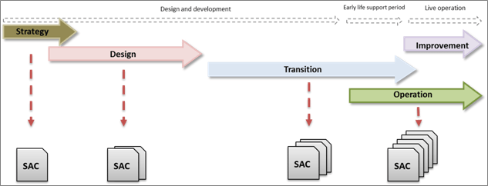
Service Acceptance Criteria (SAC)

Slide 13
Service Portfolio Design (SPD)
The service portfolio is the most critical management system used to support all processes and describes a provider’s services in the terms of business value.
Service portfolio should form part of Service Knowledge Management System (SKMS).
The service portfolio is designed by Service Design but managed by the Service Portfolio Management process which is a part of the Service Strategy Lifecycle.
Contains information relating to every service and its current status within the organization. The service catalogue will be a subset of the Service Portfolio, as it will only contain the services which are currently live.

Slide 14
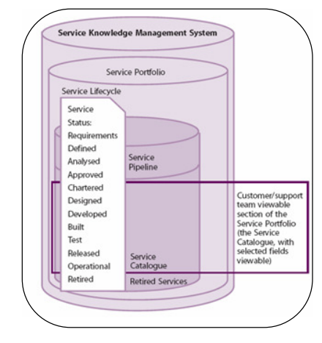
Service Knowledge Management System (SKMS)

Slide 15
“If you can’t measure it, you cant manage it”
There are four types of metrics that can be used to measure the capability and performance of processes:
Progress: milestones and deliverables in the capability of the process.
Compliance: compliance of the process to governance requirements, regulatory requirements and compliance of people to the use of the process.
Effectiveness: the accuracy and correctness of the process and its ability to deliver the ‘right result’.
Efficiency: the productivity of the process, its speed, throughput and resource utilization.

Slide 16
Sourcing Options
Insourcing: This approach relies on utilizing internal organizational resource in the design, development, transition, maintenance, operation and / or support of new, changed or revised services or data center operations.
Outsourcing: This approach utilizes the resources of an external organization or organizations in a formal arrangement to provide a well defined portion of a service’s design, development, maintenance, operations and/or support. This includes the consumption of services from Application Service Providers (ASPs) described below.
Co-sourcing: Often a combination of insourcing and outsourcing, using a number of outsourcing organizations working together to cosource key elements within the lifecycle. This generally involves using a number of external organizations working together to design, develop, transition, maintain, operate and/or support a portion of a service
Partnership or multi-sourcing: Formal arrangements between two or more organizations to work together to design, develop, transition, maintain, operate and/or support IT service(s). The focus here tends to be on strategic partnerships that leverage critical expertise or market opportunities.

Slide 17
Sourcing Process Options
Business Process Outsourcing (BPO): The increasing trend of relocating entire business functions using formal arrangements between organizations where one organization provides and manages the other organization’s entire business process(es) or functions(s) in a low-cost location. Common examples are accounting, payroll and call center operations
Knowledge Process Outsourcing (KPO): The newest form of outsourcing, KPO is a step ahead of BPO in one respect. KPO organizations provide domain-based processes and business expertise rather than just process expertise, and require advanced analytical and specialized skills from the outsourcing organization

Slide 18
Processes covered under Service Design
Service Catalogue Management;
Service Level Management;
Capacity Management;
Availability Management;
IT Service Continuity Management;
Information Security Management;
Supplier Management.

Slide 19
1) Service Catalogue
A service catalogue has two aspects:
The business service catalogue,
which describes the details of a service especially the relationship with the business units and the business processes. The business service catalogue represents the customer view on the service catalogue.
The technical service catalogue
which defines the relationships between the supported services, applications and technical components. The technical service catalogue underpins the business service catalogue, but is not part of the customer view.

Slide 20
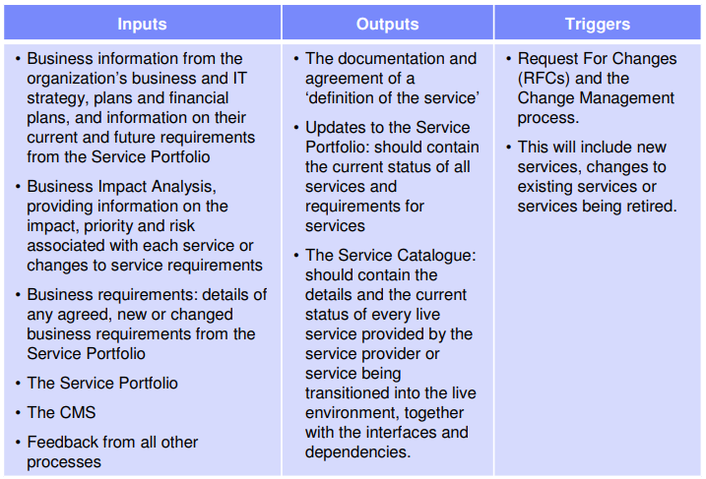
Service Catalogue Process

Slide 21
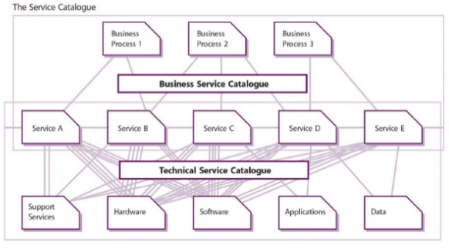
Service Catalogue Example of Aspects

Slide 22
2) Service Level Management
The objective of service level management is to ensure the provision of the agreed quality for all existing services and that future services can be delivered according to the agreed and reachable goals. Proactive measuring is intended to help identify and implement service improvements.
In order to meet the growing demand, customers, users and service providers have to properly understand each other. Service level management (SLM) is the best platform for this. SLM is the central function of IT service management and has the task of aligning the business requirements with the economically viable possibilities of the IT service organization.
The goal of these negotiations is to agree, secure, monitor and control the service level agreements (SLAs) with clearly measureable targets for service quality. Before the customer’s service level requirements can be agreed they have to be secured by the internal and external partners of the IT service management organization. This requirement of IT services requires a breakdown of the individual services into sub-components.

Slide 23
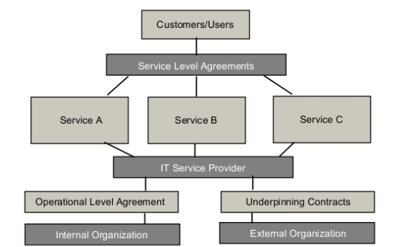
Service Level Aspects

Slide 24
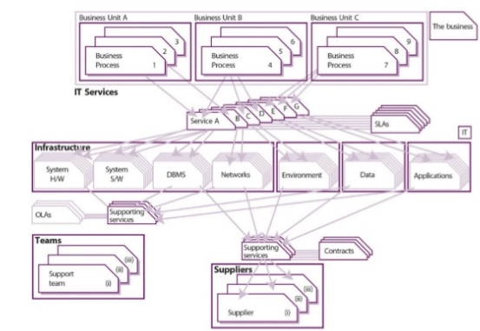
Service Level Aspects

Slide 25
Negotiated with Customer
Service Level Agreement
It is a written agreement between an IT service provider and the customers. Defines the key service targets and responsibilities of both parties.
Service Level Objective
Are agreed upon as a means of measuring the performance of the Service Provider and are outlined as a way of avoiding disputes between the two parties based on misunderstanding.

Slide 26
Negotiated by Internal Teams
Operational Level Agreement
OLA is an agreement between an IT service provider and another part of the same organization that assists with the provision of services. Example: Facilities department that maintains the air conditioning Network support team that supports the network service An OLA should contain targets that underpin those within an SLA to ensure that targets will not be breached by failure of the supporting activity.

Slide 27
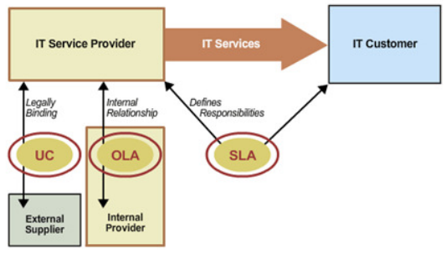
Underpinning Contracts
Negotiated with Partners

Slide 28
SLM Activities
Design SLA frameworks
Using the Service Catalogue as an aid, SLM must design the most appropriate SLA structure to ensure that all services and all customers are covered in a manner best suited to the organization’s needs.
Service-based SLA :
SLA covers one service, for all the customers of that service. Example, an SLA may be established for an organization’s e-mail service - covering all the customers of that service. where common levels of service are
Customer-based SLA :
This is an agreement with an individual customer roup, covering all the services they use. For example, agreements may be reached with an organization’s finance department covering, say, the finance system, the accounting system, the payroll system, the billing system, the procurement system, and any other IT systems that they use. Customers often prefer such an agreement, as all of their requirements are covered in a single document.

Slide 29
Service Level Manager
Responsible for ensuring that the aims of Service Level Management are met. This includes responsibilities such as:
Keeping aware of changing business needs;
Ensuring that the current and future service requirements of customers are identified;
Understood and documented in SLA and SLR documents
Negotiating and agreeing levels of service to be delivered with the customer (either internal or external);
Formally documenting these levels of service in SLAs
Negotiating and agreeing OLAs.

Slide 30
3) Capacity Management
This process that extends across the Service Lifecycle. A key success factor in managing capacity is ensuring it is considered during the design stage.
It is supported initially in Service Strategy where the decisions and analysis of business requirements and customer outcomes influence the development of:
patterns of business activity (PBA);
levels of service (LOS);
service level packages (SLPs).
This provides the predictive and ongoing capacity indicators needed to align capacity to demand.

Slide 31
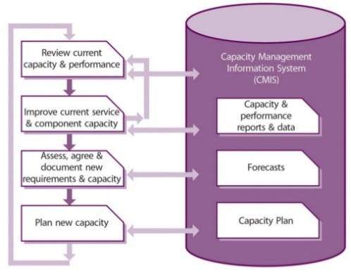
Capacity Management Process Flow

Slide 32
4) Availability Management (AM)
- Ensures that the level of service availability delivered in all services matches or exceeds the current and future agreed-upon needs of the business in a cost-effective manner
- Provides a point of focus and management for all availability-related issues for both services and resources
- Ensures that availability targets in all areas are measured and achieved

Slide 33
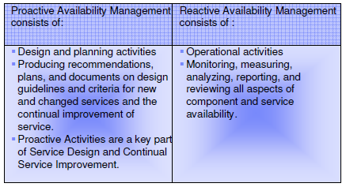
Proactive Versus Reactive Availability Management

Slide 34
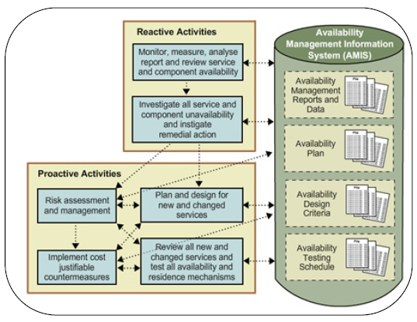
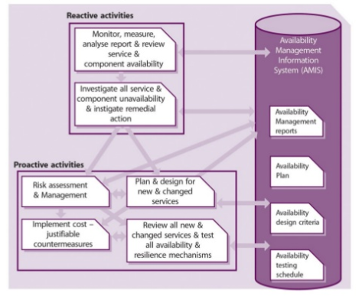
Proactive Versus Reactive Availability Management

Slide 35
AM Basic Concepts
Availability is the ability of a service, component, or CI to perform its agreed-upon function when required. It is often measured and reported as a percentage;
Reliability is a measure of how long a service, component, or CI can perform its agreed-upon function without interruption. The reliability of the service can be improved by increasing the reliability of individual components or by increasing the resilience of the service to individual component failure (such as increasing the component redundancy, for example by using load balancing techniques);
Resilience is the the capability of a set of CIs to continue to provide a required function when one or more CIs in the set have suffered a failure;
Maintainability is a measure of how quickly and effectively a service, component, or CI can be restored to normal working after a failure. It is measured and reported as Mean Time to Restore Service (MTRS) and should be calculated using the following formula shown.

Slide 36
AM Basic Concepts
Serviceability : The ability of a supplier to meet the terms of the contract. Often this contract will include agreed- upon levels of availability, reliability, and maintainability for a supporting service or componente;
High Availability : A characteristic of the IT Service that minimizes or masks the effects of IT component failure to the users of a servisse;
Continuous Operation : Eliminate planned downtime of an IT service;
Continuous Availability: An approach or design to IT service has no planned or unplanned downtime;
Vital Business Function (VBF): is used to reflect the business critical elements of the business process supported by an IT service. An IT service may support a number of business functions that are less critical.

Slide 37
Availability Management
Incident Life Cycle
System Down
Detection
Diagnosis
Repair
Recovery
Mean Time To Detect (MTTD)
MTRS = MTTD + MTTR (Dowtime)
MTBF = Availability
MTBSI = MTTR + MTBF
Mean Time to Repair (MTTR)
Recovery Time
Mean Time to Restore Service (MTRS)
Mean Time Between Failures (MTBF)
Mean Time to Failure (MTTF)
Mean Time Between System Incidents (MTBSI)
Incident
Incident
Notes:
A guiding principle of Availability Management is to recognize that it is still possible to gain customer satisfaction even when things go wrong. One approach to help achieve this requires Availability Management to ensure that the duration of any Incident is minimized to enable normal business operations to resume as quickly as possible.
Availability Management should work closely with Incident Management and Problem Management in the analysis of unavailability Incidents.
A good technique to help with the technical analysis of Incidents affecting the availability of components and IT services is to take an Incident “lifecycle” view. Every Incident passes through several major stages. The time elapsed in these stages may vary considerably. For Availability Management purposes, the standard Incident “lifecycle”, as described within Incident Management, has been expanded to provide additional help and guidance, particularly in the area of “designing for recovery”.
MTBF (Mean Time Between Failures) is the average elapsed time from the time an IT service or supporting component is fully restored until the next occurrence of a failure to the same service or component.
MTBSI (Mean Time Between System Incidents) is the average elapsed time between the occurrence of one failure and the next failure.
MTTR (Mean Time To Repair) is the average elapsed time from the occurrence of an Incident to resolution of the Incident.

Slide 38
5) IT Service Continuity Management (ITSCM)
The goal is to support the overall Business Continuity by ensuring that the required IT technical and service facilities can be resumed within required, and agreed, business timescales;
As technology is a core component of most business processes, continued or high availability of IT is critical to the survival of the business as a whole. This is achieved by introducing risk reduction measures and recovery options;
Successful implementation of ITSCM can only be achieved with senior management commitment and the support of all members of the organization. Ongoing maintenance of the recovery capability is essential if it is to remain effective;
The purpose is to maintain the necessary ongoing recovery capability within the IT services and their supporting components.

Slide 39
Business Continuity Plan (BPC)
It describes the Plan or approach to ensure the continuity of Vital Business Functions (VBF) in the case of disaster events.
The BPC is prepared by the business continuity management team and serves as a reference point for producing the IT Service Continuity Strategy.
Disaster Recovery Invocation Guideline:
A document produced by ITSCM with detailed instructions and steps to be followed in case any disaster occurs. This guideline also defines the first steps to be taken by 1st Level Support in case they suspect about disaster occurrence.

Slide 40
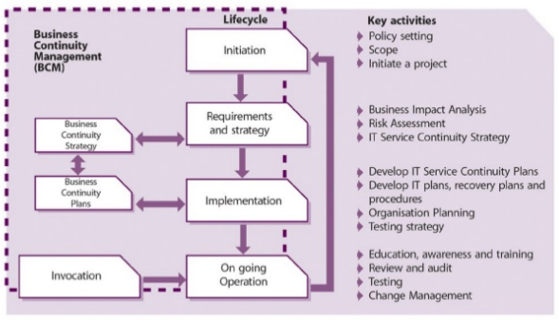
BCM Lifecycle approach

Slide 41
BCM initiation phase
The initiation phase covers policy setting, specify terms of reference, scope, allocate resources, etc. The Requirements and Strategy stage can effectively be split into two sections:
Requirements – perform Business Impact Analysis (BIA) and risk assessment;
Strategy – following the requirements analysis, the strategy should document the required risk reduction measures and recovery options to support the business.

Slide 42
Recovery Options
The following is a list of the potential IT recovery options that need to be considered when developing the strategy:
Manual work-arounds;
Reciprocal arrangements;
Gradual recovery;
Intermediate recovery;
Fast recovery;
Immediate recovery.

Slide 43
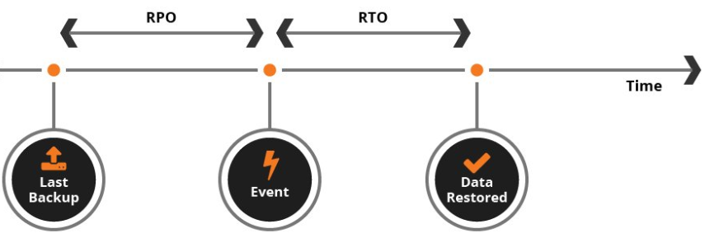
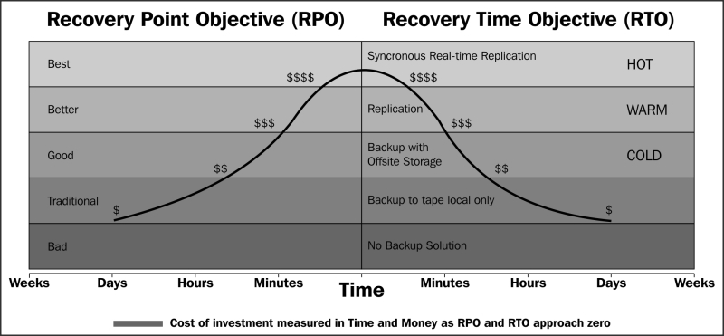
RPO and RTO

Slide 44
6) Information Security Management
Goal
The goal of the ISM process is to align IT security with business security and ensure that information security is effectively managed in all service and Service Management activities
Objective
The objective of information security is to protect the interests of those relying on information, to protect the systems and communications that deliver the information, from harm resulting from failures of availability, confidentiality and integrity.

Slide 45
For most organizations, the security objective is met when:
Information is available and usable when required, and the systems that provide it can appropriately resist attacks and recover from or prevent failures (availability);
Information is observed by or disclosed to only those who have a right to know (confidentiality);
Information is complete, accurate and protected against unauthorized modification (integrity);
Business transactions, as well as information exchanges between enterprises, or with partners, can be trusted (authenticity and non-repudiation).

Slide 46
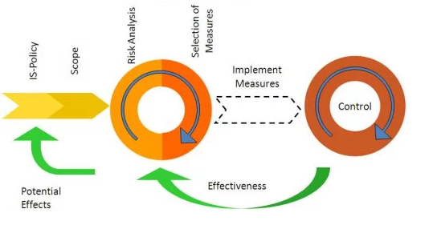
Information Security Management System (ISMS)

Slide 47
Basic Concepts
Security Controls: At the start there is a risk that a threat will materialize. A threat can be anything that disrupts the business process or has negative impact on the business. When a threat materializes, we speak of a security incident. This security incident may result in damage (to information or to assets) that has to be repaired or otherwise corrected. Suitable measures can be selected for each of these stages;
Preventive: security measures are used to prevent a security incident from occurring;
Reductive: further measures can be taken in advance to minimize any possible damage that may occur;
Detective: if a security incident occurs, it is important to discover it as soon as possible – detection;
Repressive: measures are then used to counteract any continuation or repetition of the security incident;
Corrective: The damage is repaired as far as possible using corrective measures.

Slide 48
7) Supplier Management
Goal
The goal of the Supplier Management process is to manage suppliers and the services they supply, to provide seamless quality of IT service to the business, ensuring value for money is obtained.
The main objectives of the Supplier Management process are to:
Obtain value for money from supplier and contracts
Ensure that underpinning contracts and agreements with suppliers are aligned to business needs, and support and align with agreed targets in SLRs and SLAs, in conjunction with SLM
Manage relationships with suppliers
Manage supplier performance
Negotiate and agree contracts with suppliers and manage them through their lifecycle
Maintain a supplier policy and a supporting Supplier and Contract Database (SCD).

Slide 49
Scope
The Supplier Management process should include the management of all suppliers and contracts needed to support the provision of IT services to the business.
The Supplier Management process should include:
Implementation and enforcement of the supplier policy;
Maintenance of a Supplier and Contract Database (SCD);
Supplier and contract categorization and risk assessment;
Supplier and contract evaluation and selection;
Development, negotiation and agreement of contracts;
Contract review, renewal and termination;
Management of suppliers and supplier performance;
Agreement and implementation of service and supplier improvement plans;
Maintenance of standard contracts, terms and conditions;
Management of contractual dispute resolution;
Management of sub-contracted suppliers.

Slide 50
Supplier Categorization
The amount of time and effort spent managing the supplier and the relationship can then be appropriate to its categorization:
Strategic: for significant ‘partnering’ relationships that involve senior managers sharing confidential strategic information to facilitate long-term plans. These relationships would normally be managed and owned at a senior management level within the service provider organization, and would involve regular and frequent contact and performance reviews.
Tactical: for relationships involving significant commercial activity and business interaction. These relationships would normally be managed by middle management and would involve regular contact and performance reviews, often including ongoing improvement programs.
Operational: for suppliers of operational products or services. These relationships would normally be managed by junior operational management and would involve infrequent but regular contact and performance reviews.
Commodity: for suppliers that provide low-value and/or readily available products and services, which could be alternatively sourced relatively easily

Slide 51
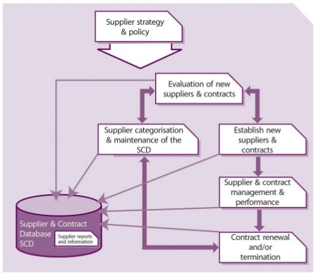
Supplier and Contracts Database (SCD)

Slide 52
Supplier and Contracts Database (SCD)
The information provided within the SCD will provide a complete set of reference information for all Supplier Management procedures and activities:
Supplier categorization and and maintenance of the Supplier and
Contracts database. (SD)
Evaluation and set up of new suppliers and contracts. (SD)
Establish new suppliers. (ST)
Supplier and Contract Management and performance.(SO)
Contract Renewal and termination.(SO)

Slide 53
References
HP Service Design
https://www.slideshare.net/sagaroceanic11/4-service-design-25474787
Service Design Package (SDP) Study Case Rolls Royce
https://www.slideshare.net/TonyOxley/itsmf-regional-group-service-design-package
ITIL Service Acceptance Criteria – keep control in your hands
https://advisera.com/20000academy/knowledgebase/itil-service-acceptance-criteria-keep-control-hands/
Service Catalogue
http://os.itil.org/en/vomkennen/itil/servicedesign/servicedesignprozesse/index.php

